Slide 1

617-803-7043, info@goinvo.com
661 Massachusetts Ave, Third Floor, Arlington, MA 02476

Slide 2
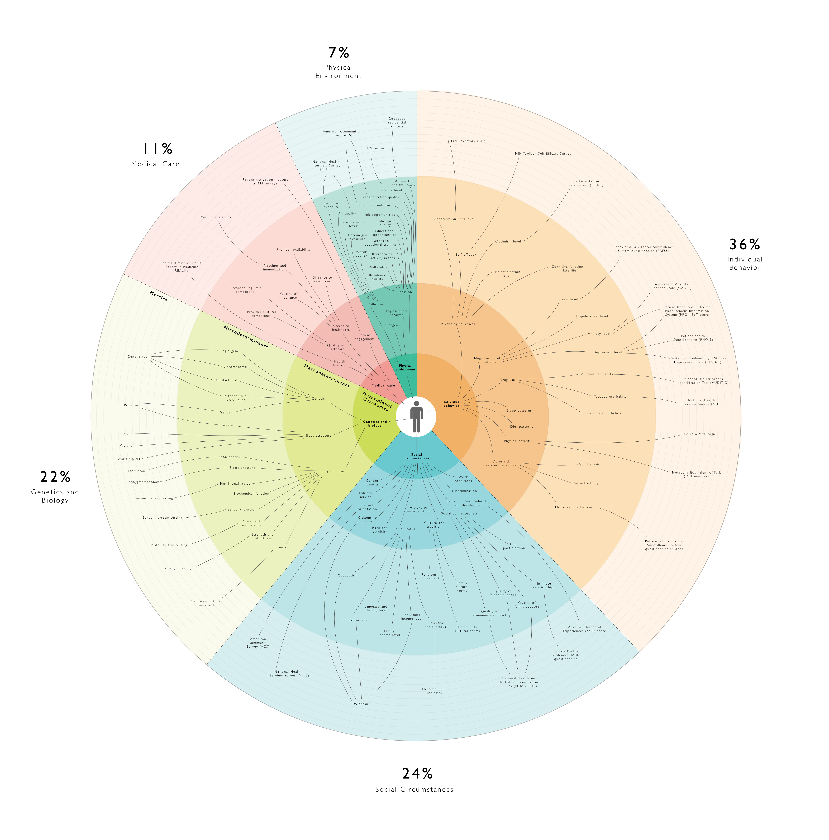
determinantsofhealth.org

Slide 3
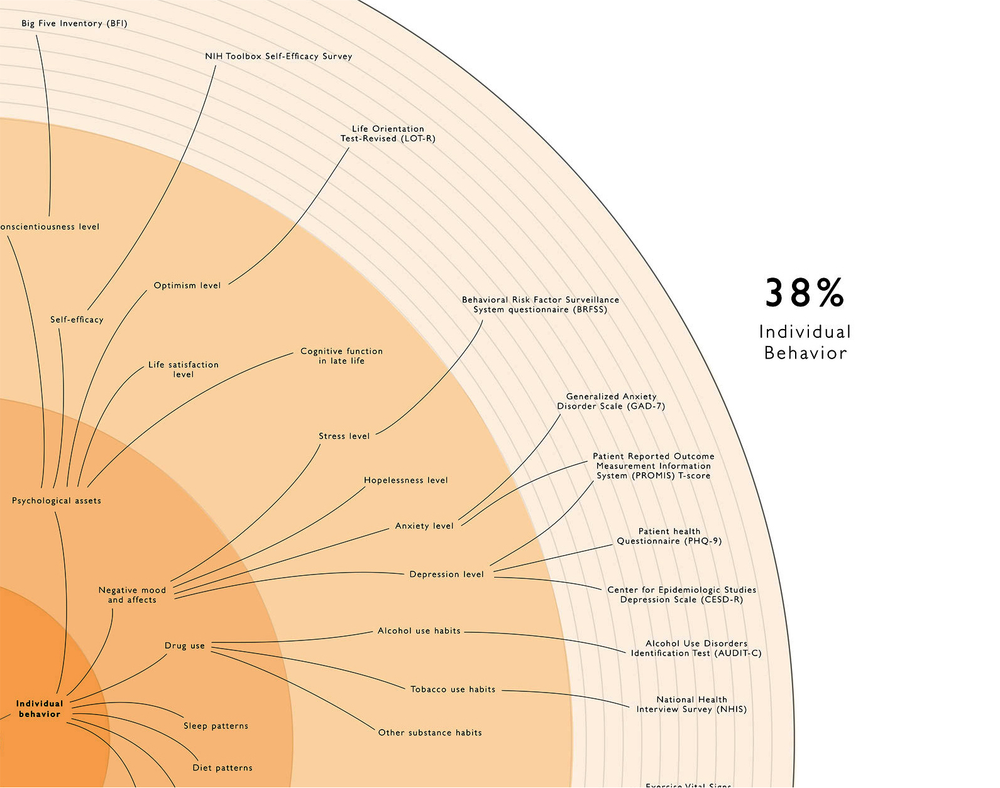

Slide 4
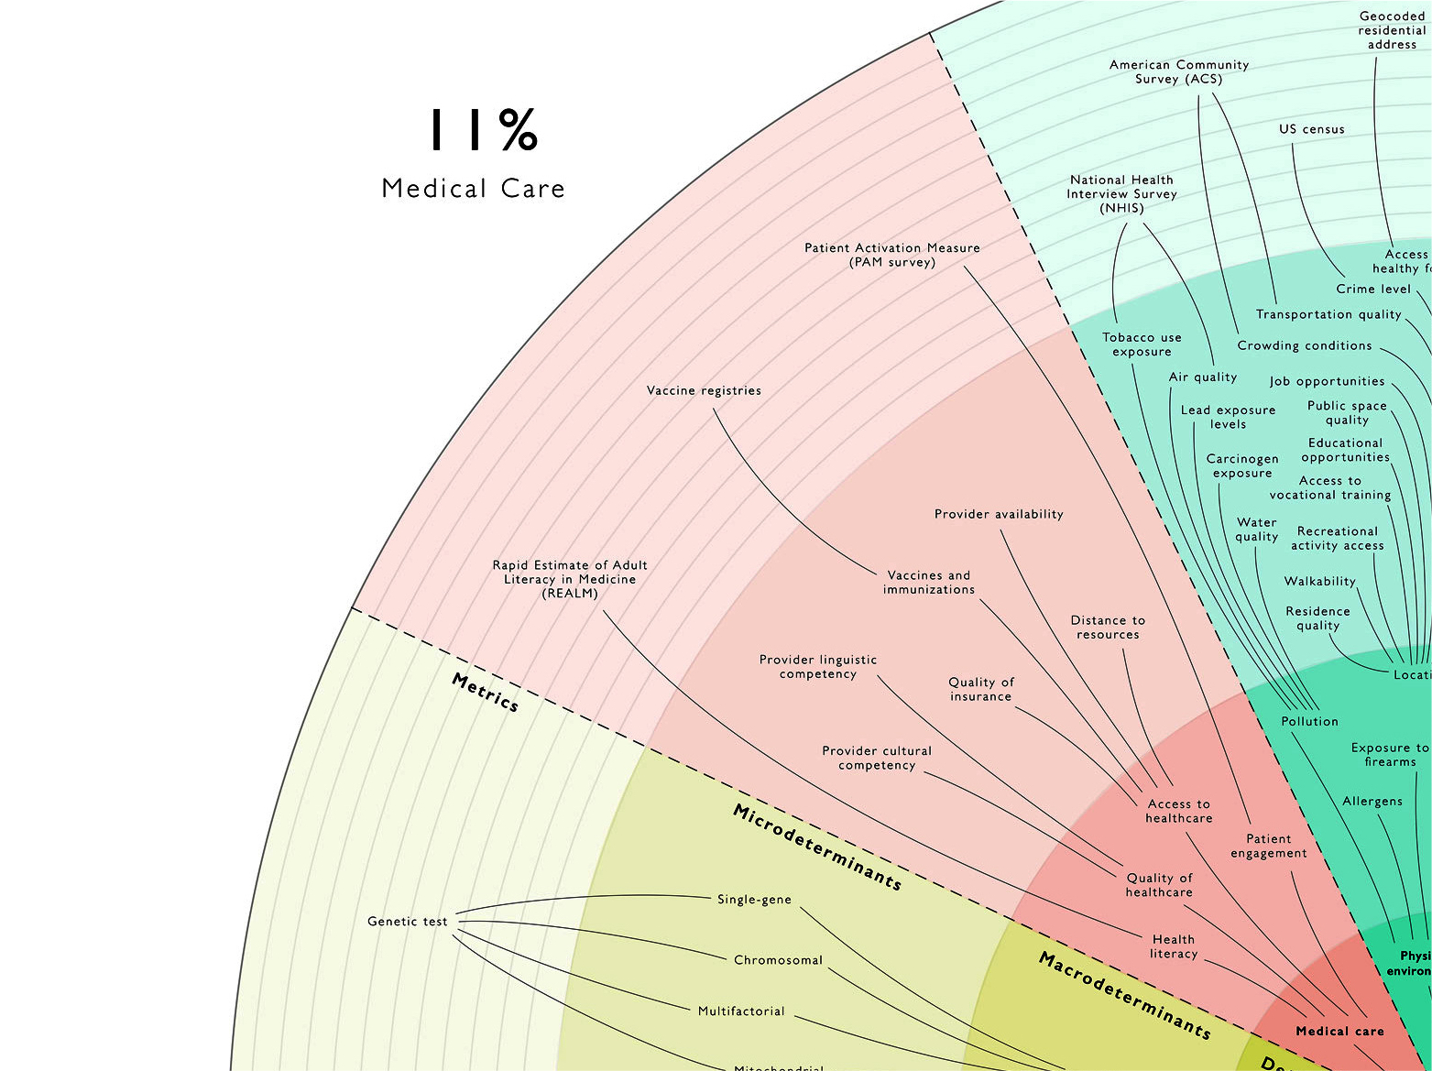

Slide 5
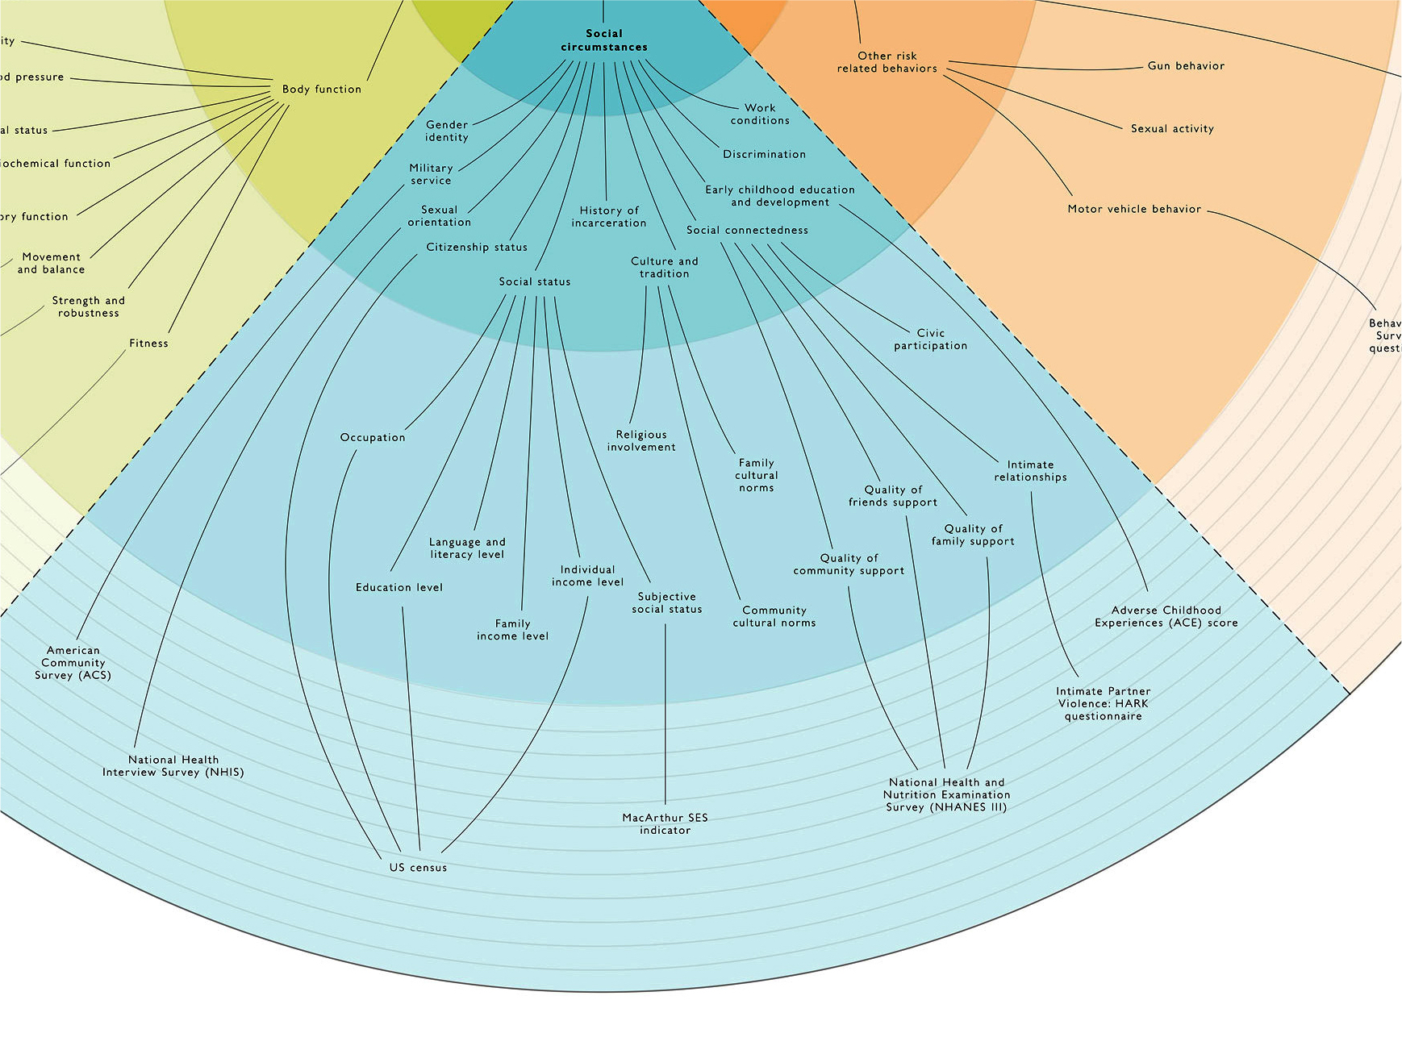
determinantsofhealth.org

